Slide 1
AI Eye Prognosticator
Group Members:
Karthik Pillai - VU4F1718038
Satyam Yadav - VU4F1718040
Mohit Saini - VU4F1718045

Slide 2
CONTENTS
Introduction
Literature survey
Abstract
Proposed system
Features of proposed system
Applications of proposed system
Working of the system
SWOT Analysis
Future Scope
Conclusion
References

Slide 3
INTRODUCTION
Developing a System which uses Computer Vision & Machine Learning to detect humans & different objects and get useful insights from the data.
To make predictions like Space utilization, People density at a point of time & number of people Incoming & Outgoing.
To analyse, how the space is utilized in a Supermarket/Mall/Shop/Highway/Road.

Slide 4
LITERATURE SURVEY
People counting and human detection in a challenging situation
Human detection in surveillance videos and its Applications
Enhancing human detection using crowd density measures and and adaptive correction filter
Real-time embedded person detection and tracking for shopping behaviour analysis
Research paper on vehicle detection and recognition

Slide 5
LITERATURE SURVEY
Paper | Year | Summary
People Counting and Human Detection in a Challenging Situation | 2011 | First, post processing steps are performed on background subtraction results to estimate the number of people in a complicated scene. Then, an Expectation Maximization (EM)-based method has been developed to locate individuals in a low resolution scene.
Human detection in surveillance videos and its applications | 2013 | Object detection is performed using background subtraction, optical flow and spatio-temporal filtering techniques. Then a moving object could be classified as a human being using shape-based, texture based or motion-based features.
Enhancing human detection using crowd density measures and an adaptive correction filter | 2016 | The proposed method applies a self-adaptive, dynamic parametrization and as an additional contribution uses scene adaptive learning of the human aspect ratio in order to reduce false positive detections in crowded areas

Slide 6
Real-time embedded person detection and tracking for shopping behaviour analysis | 2020 | Shopping behaviour analysis through counting and tracking of people in shop-like environments offers valuable information for store operators and provides key insights in the stores layout.
Research paper on vehicle detection and recognition | 2020 | This paper will introduce the processing of automatic vehicle detection and recognition using static image datasets.

Slide 7
ABSTRACT
Aim of the project is to implement a system which is capable of extracting information from the CCTV footages by using human detection algorithm to derive valuable insights from the footages.
The system uses YOLOv3 human detection algorithm (CNN Based Algorithm) to detect humans.
This data is further used by Machine Learning algorithm to make predictions regarding the human population density at a particular location, human count and path tracking.

Slide 8
PROPOSED SYSTEM
The AI Eye Prognosticator detects humans and count the number of people.
The data of the CCTV cameras is stored in the system and a huge database is created.
The raw data collected by the CCTV cameras is not used to the fullest in the current scenario.
Reading the patterns and understanding the nature of the objects, the AI Eye Prognosticator can predict the future population density in a location.
The details such as behaviour of the consumer, theirs likes and dislikes, the pattern of their shopping can be detected.
Suggestion could be given to the owners of the malls to engage more customers and enhance their business.
Space utilisation in public places can be optimised.

Slide 9
FEATURES OF PROPOSED SYSTEM
Detection of humans & counting them.
Store stats of incoming & outgoing people
Predict future incoming & outgoing people count
Track the path of a person
Predict most populated place
Analyse the density of people count
In a mall predict which shop has most customers, Which type of shop has more customers, Which part of the mall has most customers
Provide business insights to the business owners

Slide 10
APPLICATIONS OF PROPOSED SYSTEM
Shopping Malls - To get insights like, population density at a shop.
Colleges/Offices – To get number of people/students entered into college.
Retail shops – To get data like which product is least visible to consumers.
Streets/Road – To make optimum use of space.

Slide 11
WORKING OF THE SYSTEM
Start system
Detect humans & objects using YOLO Algorithm
Detect the coordinates in the video footage
Process the data according to the requirement
Store the data like timestamp, coordinates, label, dimensions & direction of motion into the database from video footage
Data preprocessing
Regression
Predictions & Insights from the data

Slide 12
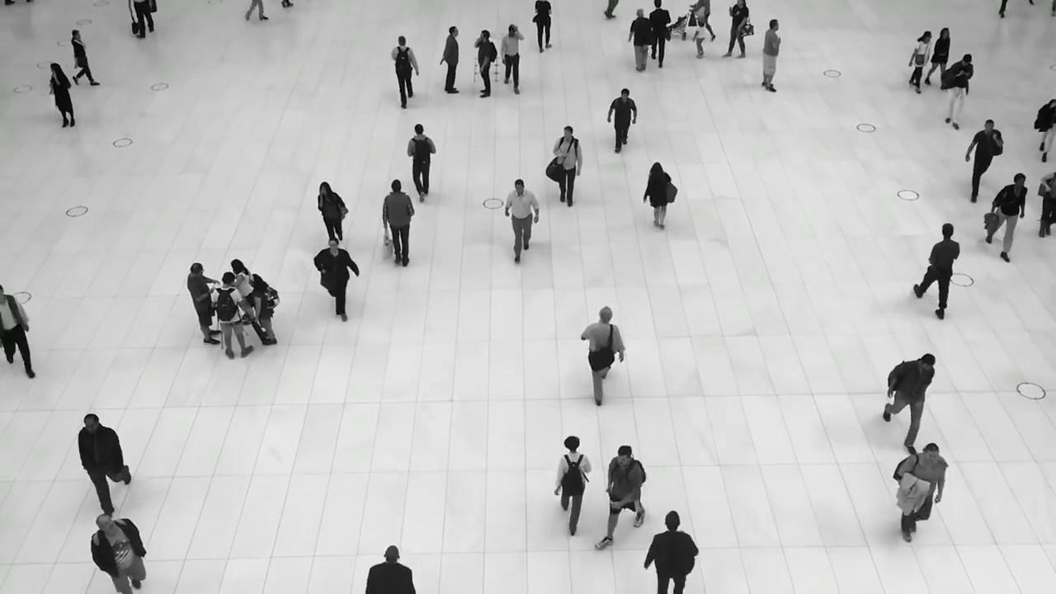

Slide 13
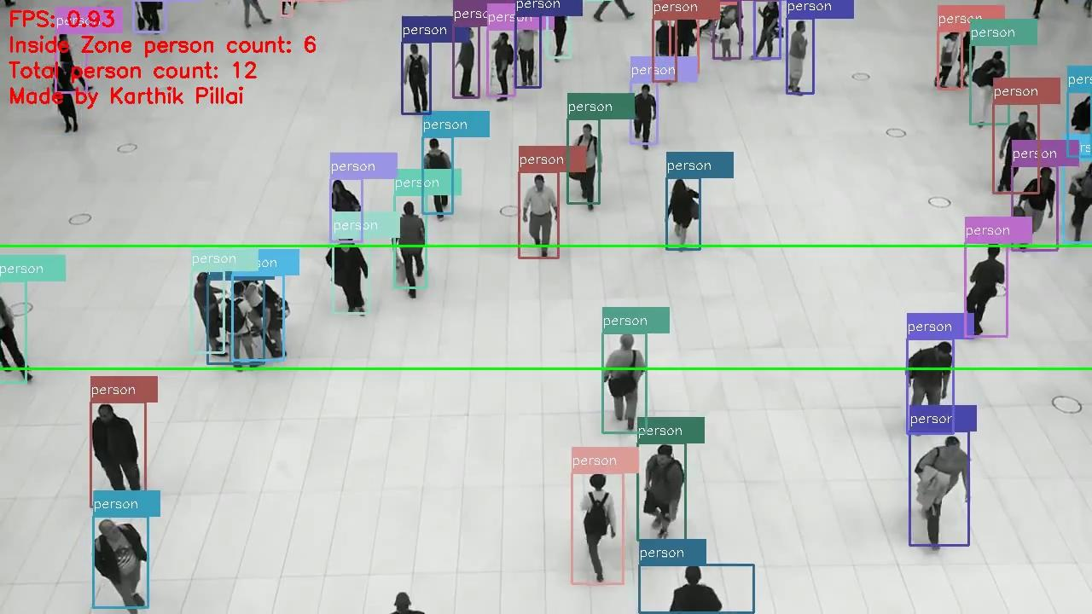

Slide 14
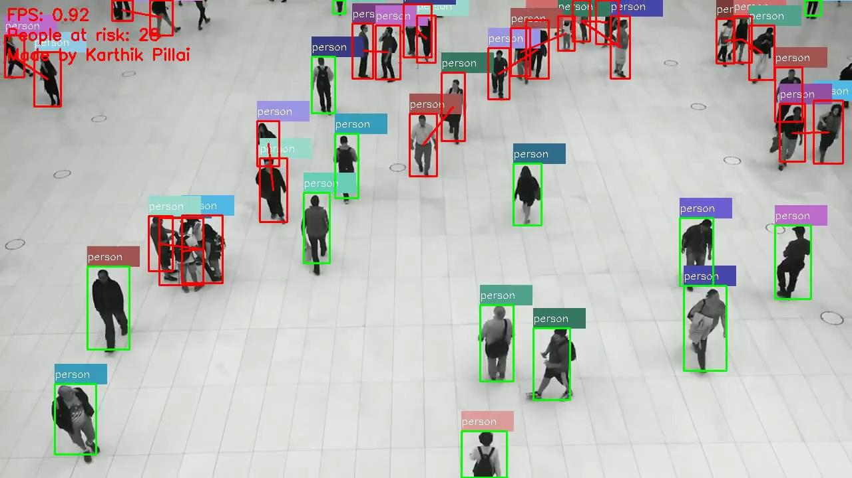

Slide 15


Slide 17
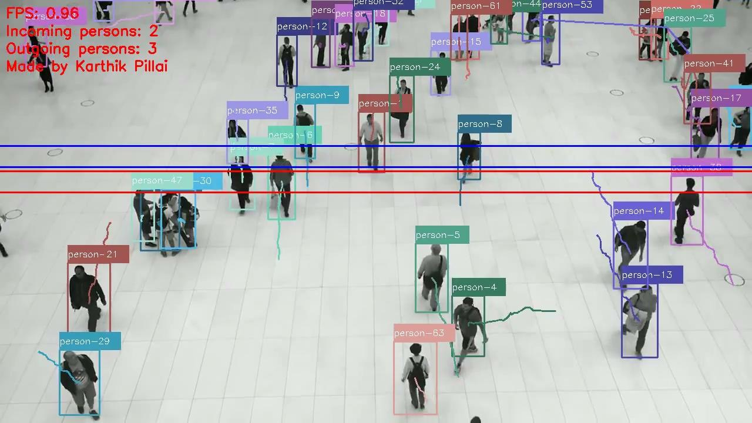

Slide 18
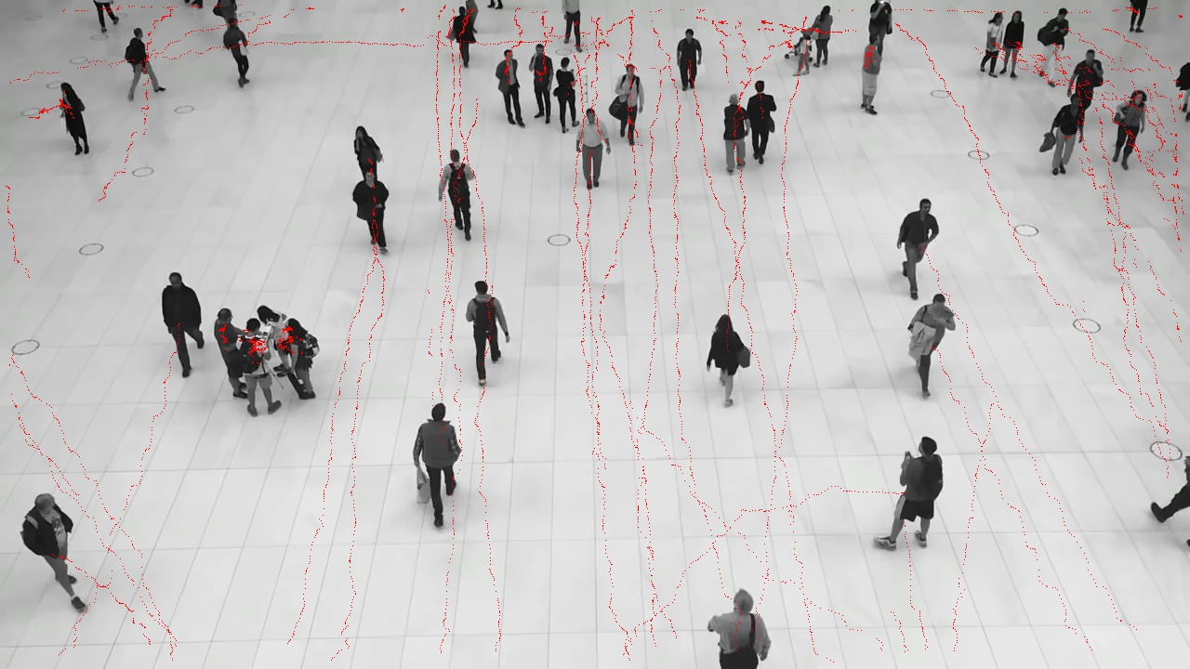

Slide 19
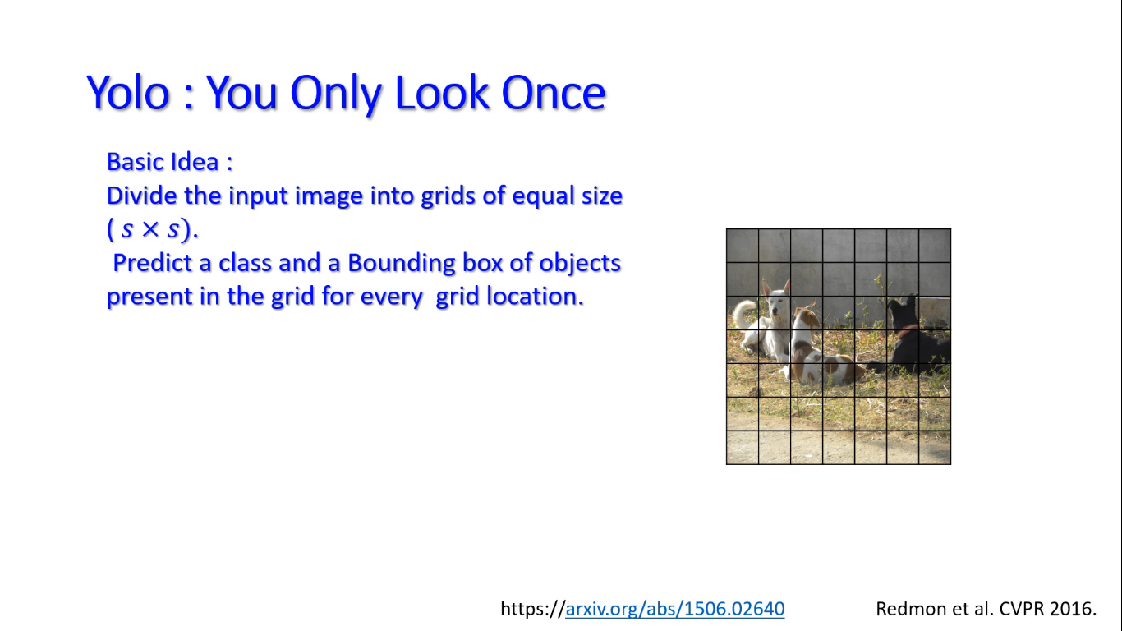
WORKING OF YOLOv3

Slide 20
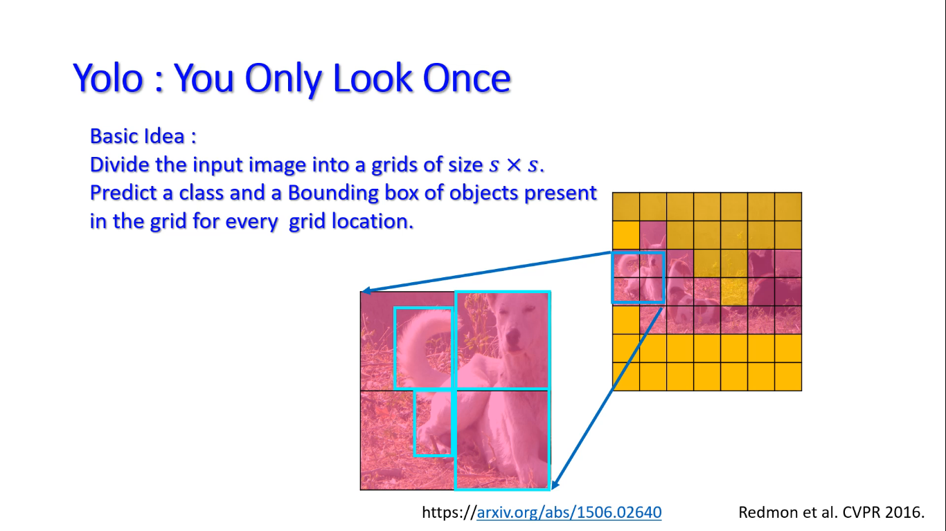

Slide 21
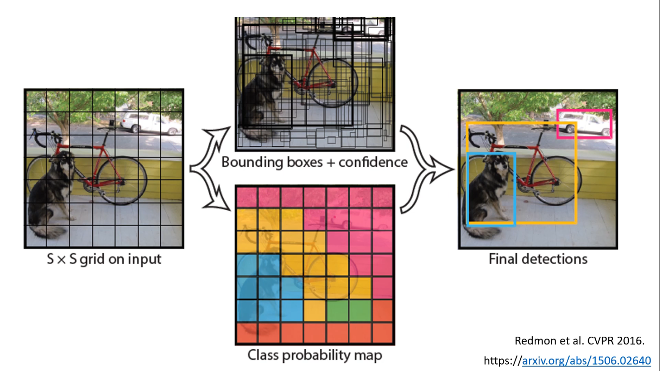

Slide 22
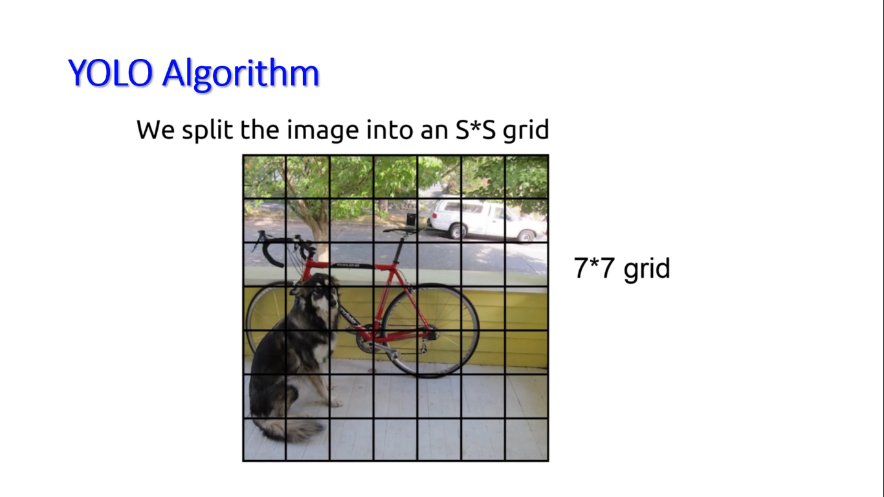

Slide 23
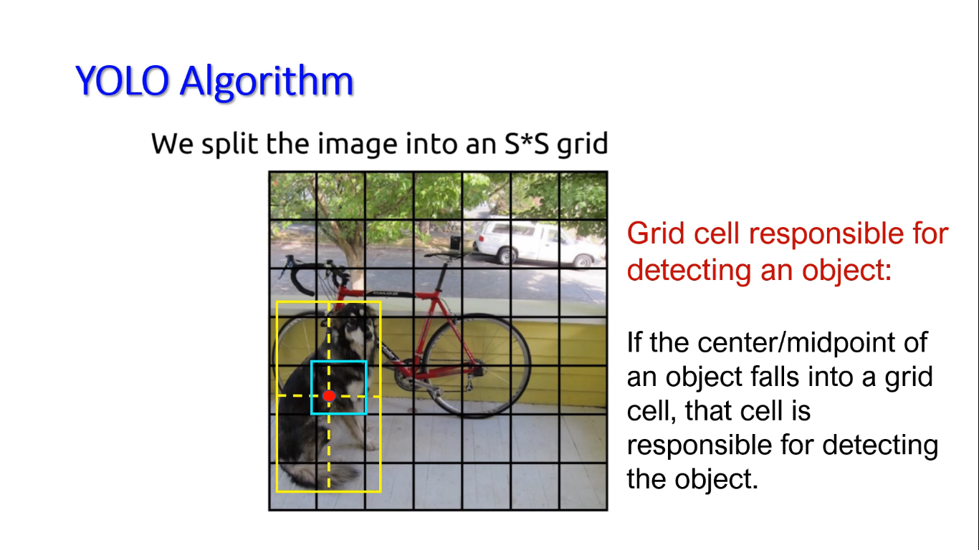

Slide 24
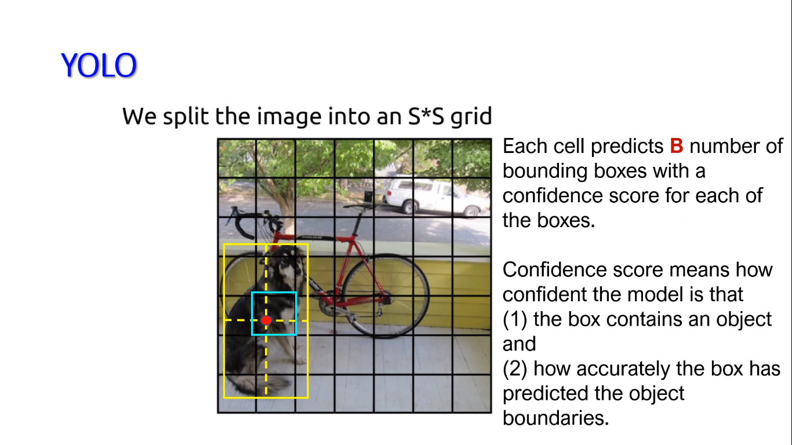

Slide 25
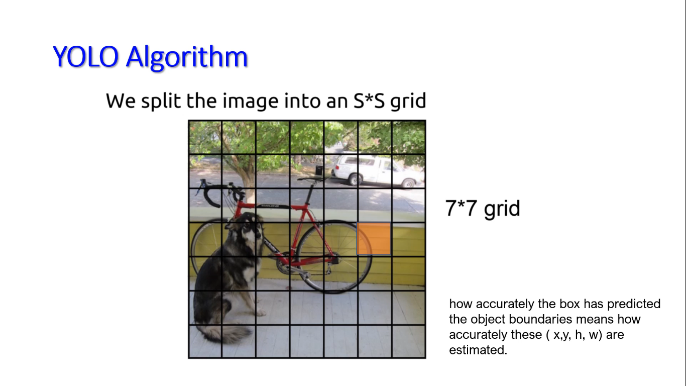

Slide 26
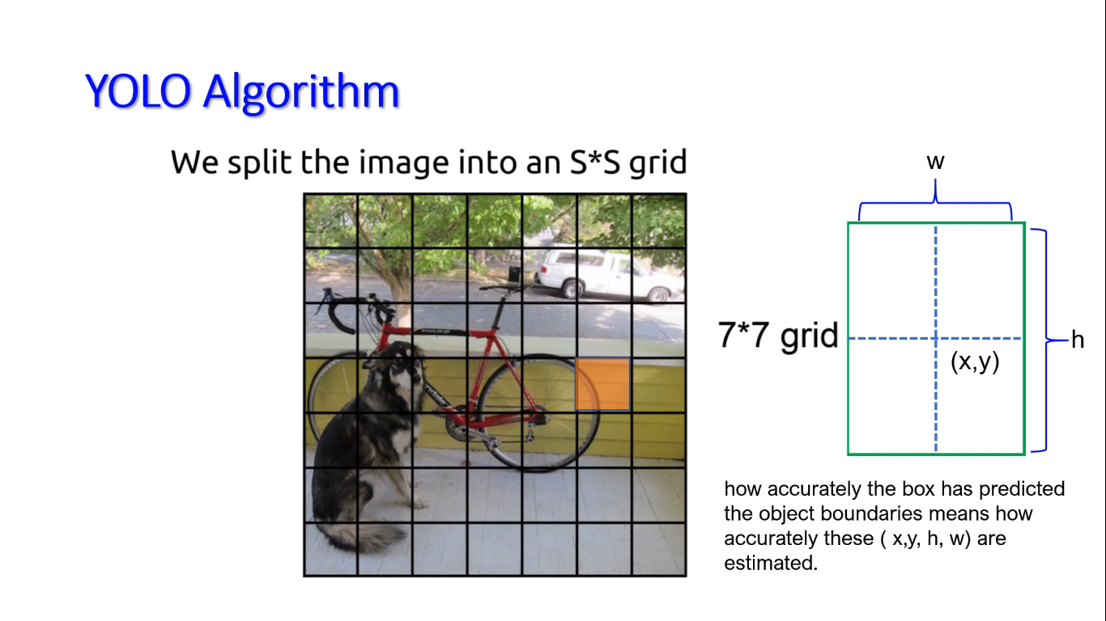

Slide 27
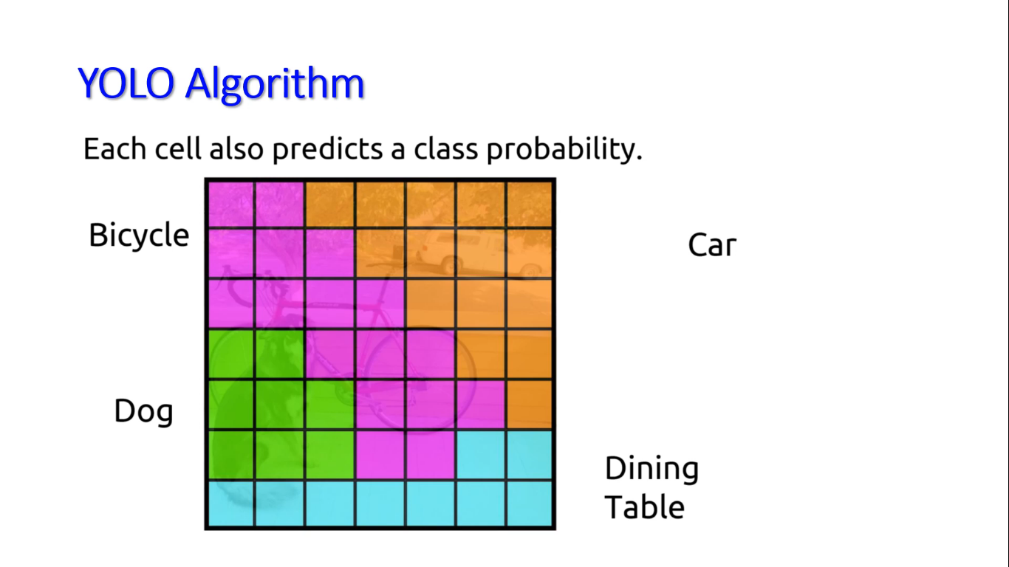

Slide 28
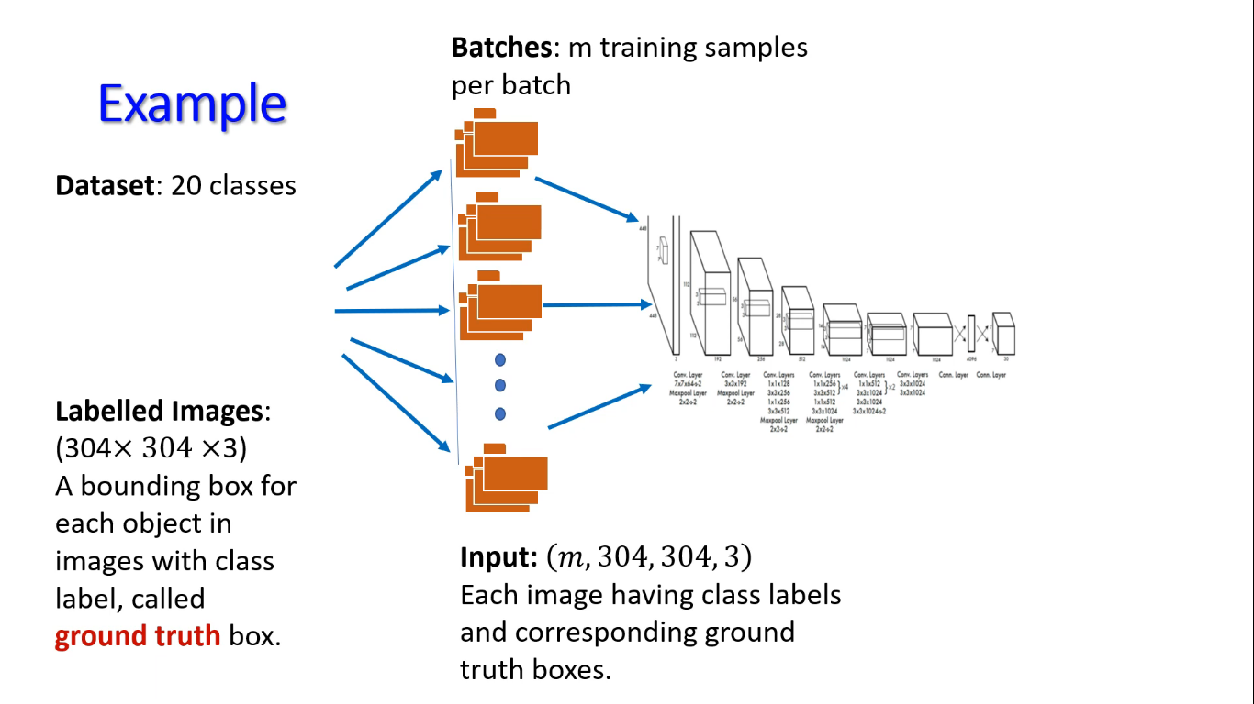

Slide 29
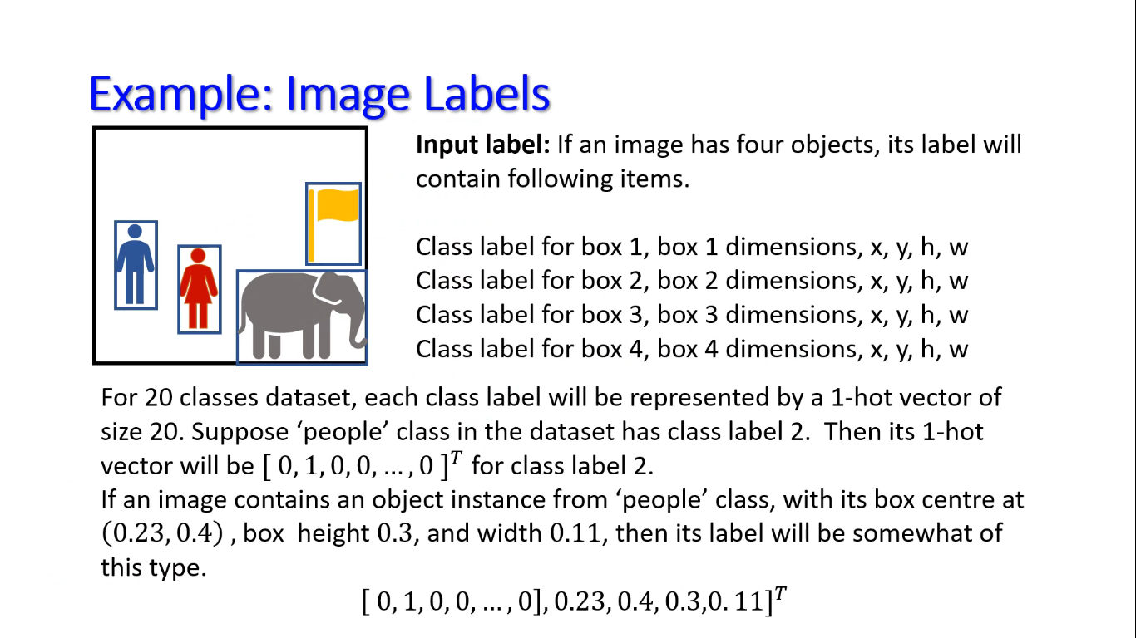

Slide 30
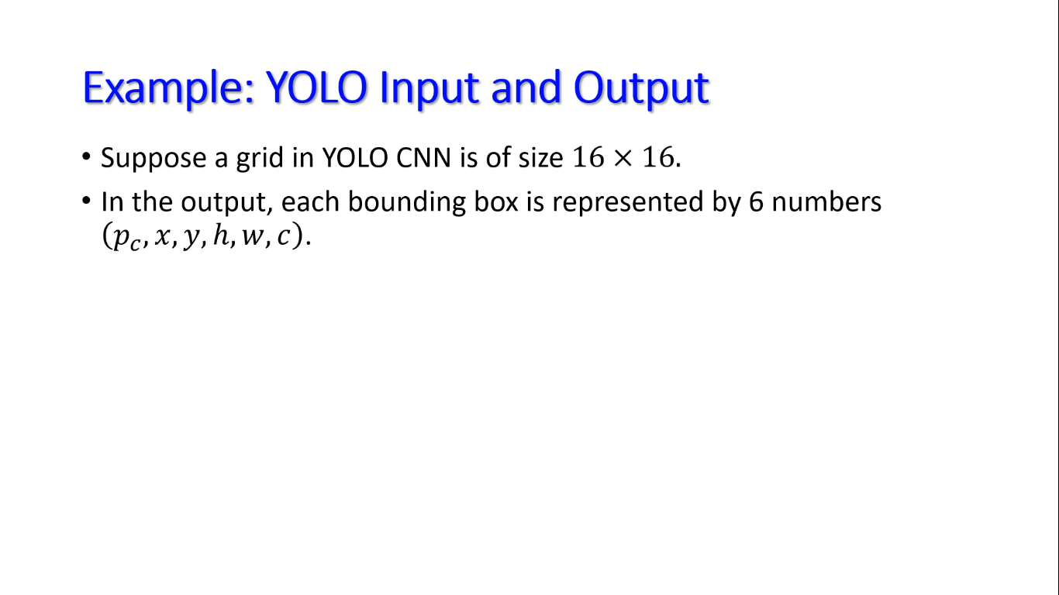


Slide 31
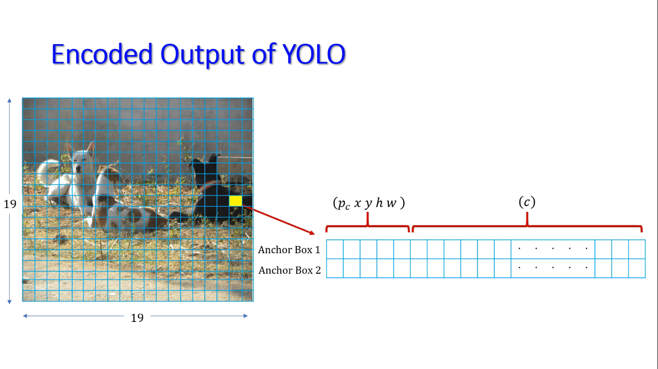

Slide 32
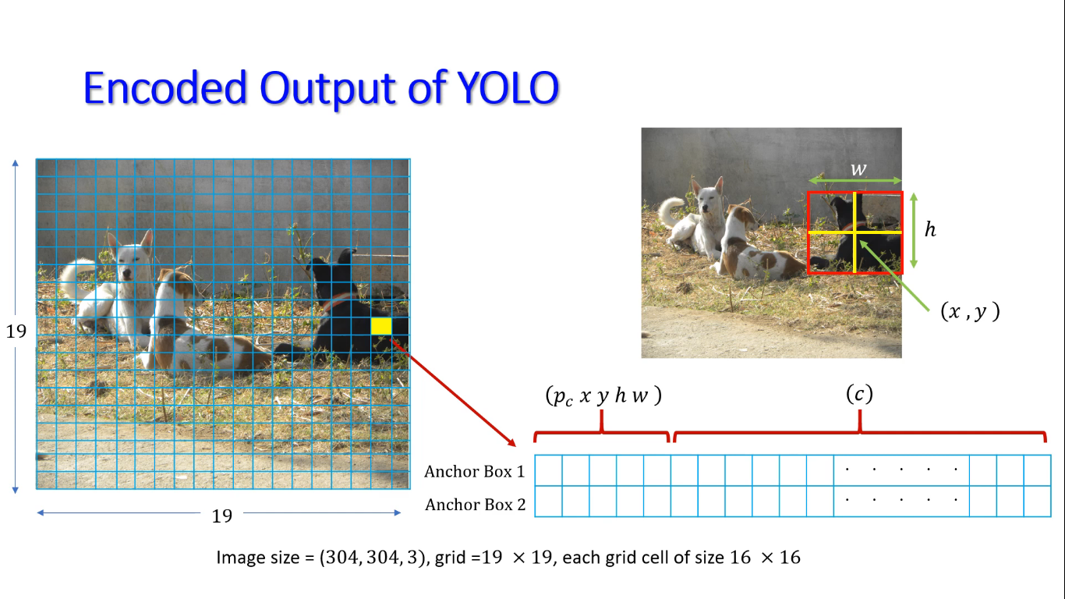

Slide 33
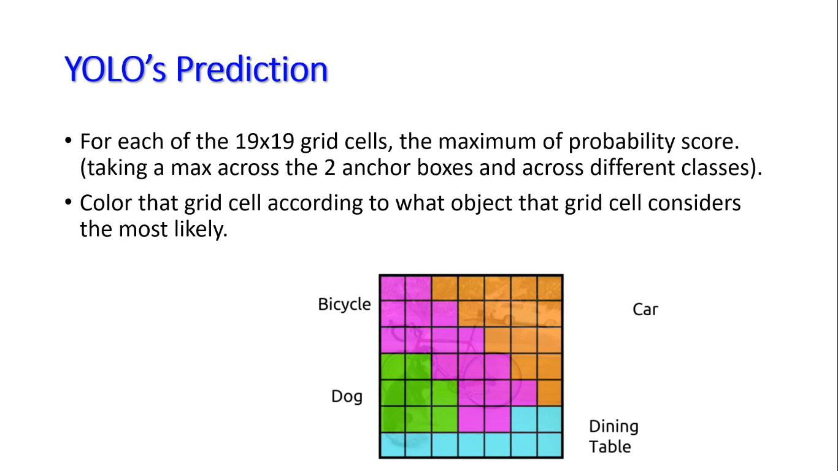

Slide 34
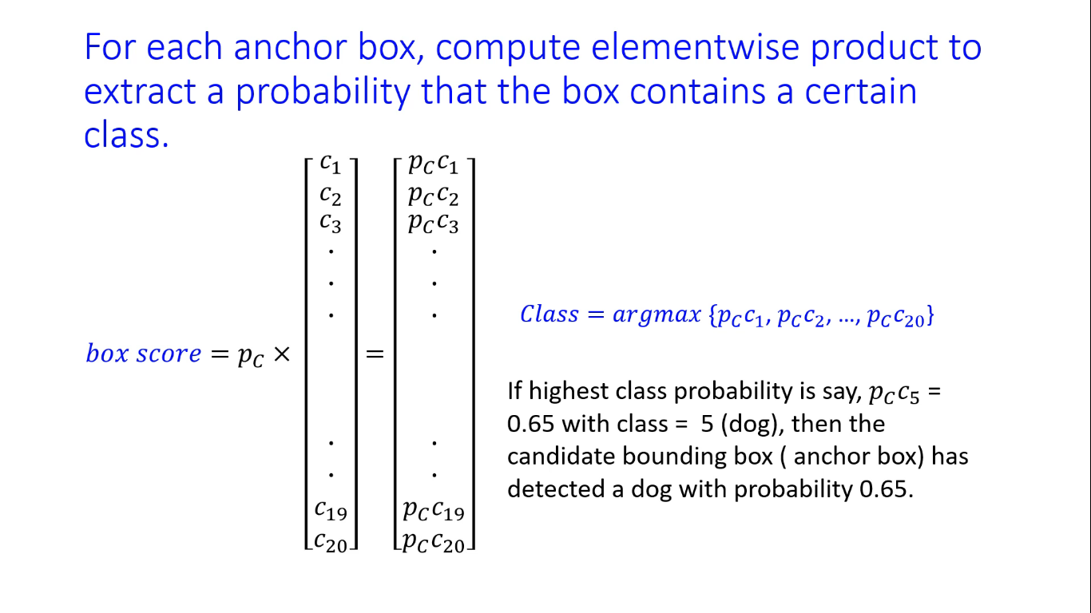

Slide 35
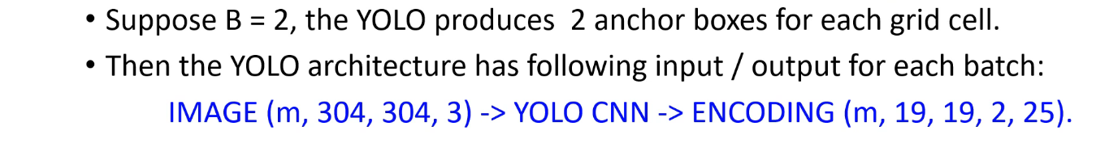

Slide 36
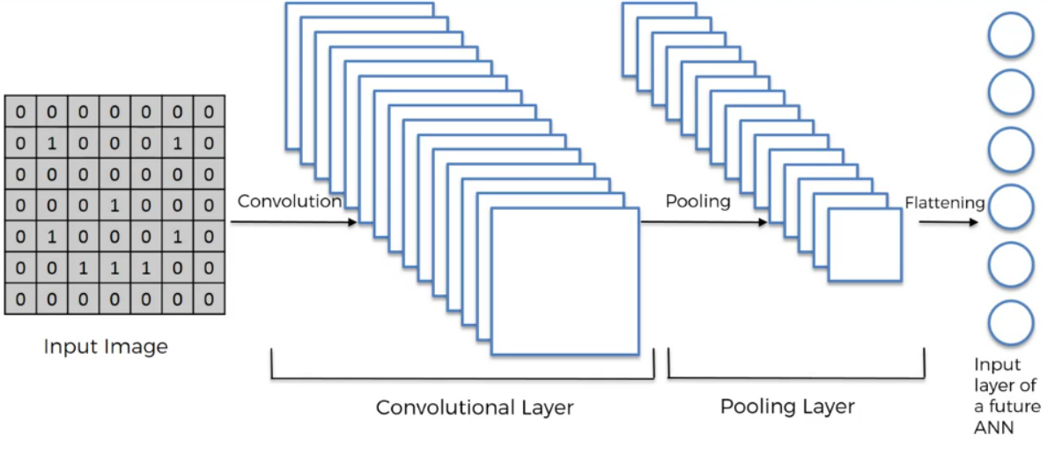
CONVOLUTIONAL NEURAL NETWORK

Slide 37
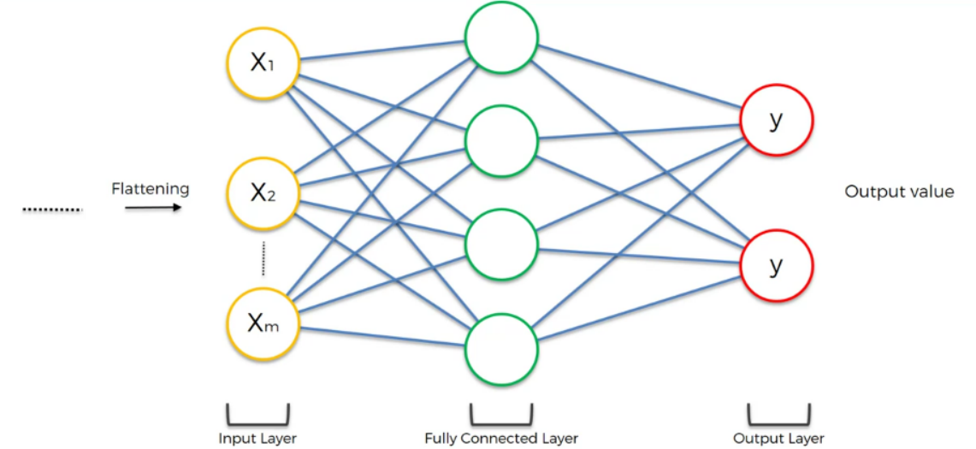
CONVOLUTIONAL NEURAL NETWORK

Slide 38
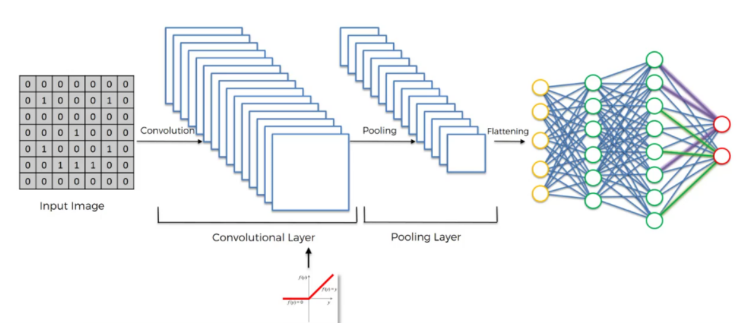
CONVOLUTIONAL NEURAL NETWORK

Slide 39




SWOT ANALYSIS
WEAKNESSES
The computing power required is high.
THREATS
Blind spots which are not covered by cctv may affect result.
STRENGTHS
Making quality decisions based on the data collected.
OPPORTUNITIES
Can be extended to be used anywhere.

Slide 40
FUTURE SCOPE
The data generated is stored in the database.
This stored data will be used as an input to the machine learning model.
The machine learning model will use regression to predict the future results.

Slide 41
CONCLUSION
A system that is useful in understanding the human density in a particular space.
Deriving business insights in an off-line store.
Managing the space effectively & efficiently.
Understanding the people movement pattern in a place & make optimized utilization of space.

Slide 42
REFERENCES
You Only Look Once: Unified, Real-Time Object Detection - https://pjreddie.com/media/files/papers/yolo.pdf
Real-time object detection and tracking in an unknown environment - https://ieeexplore.ieee.org/document/6141394
Object Detection Using Convolutional Neural Networks - https://ieeexplore.ieee.org/document/8650517
Enhancing human detection using crowd density and an adaptive correction filter - https://www.researchgate.net/publication/261044815
Research paper on vehicle detection and recognition - https://www.researchgate.net/publication/344668186

Slide 43
THANK YOU

